Slide 1
Architecting cross-platform solutions with…

Slide 2
MvvmCross
v3 - Hot Tuna

Slide 3

KEEP CALM AND EVOLVE

Slide 4



Mvc
THANKS TO JEREMY LIKNESS
FOR THE PICTURES!

Slide 5

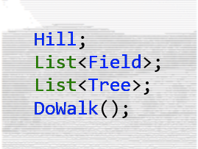
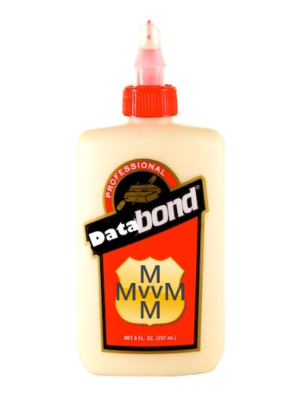
Mvvm

Slide 6

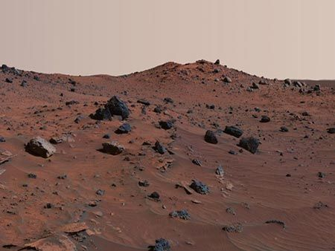

Mvx

Slide 7
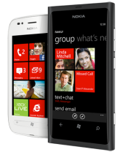
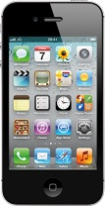
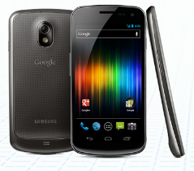
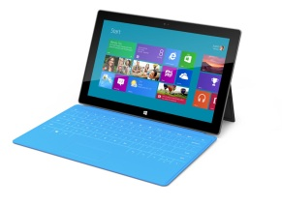
MvvmCross
MVVMCROSS
DataBinding, IoC, Plugins, Trace, INPC, Collections, Helpers, …
Xamarin.iOS
Xamarin.Android
Core
Portable Class Library
Windows 8
WindowsPhone 8
WPF

Slide 8

KEEP CALM AND CODE

Slide 9

Hero break…

Slide 10
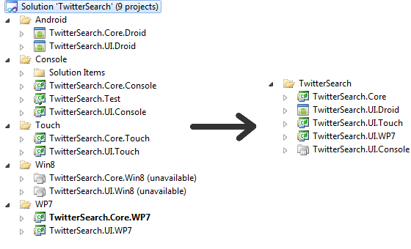
PCL

Slide 11

IoC
Use interfaces
Choose what implements those interfaces at runtime.
Job done.

Slide 12
CoC
HomeView
HomeViewModel
ListView
ListViewModel
DetailView
DetailViewModel

Slide 13




TAiK-iK-iK

Slide 14
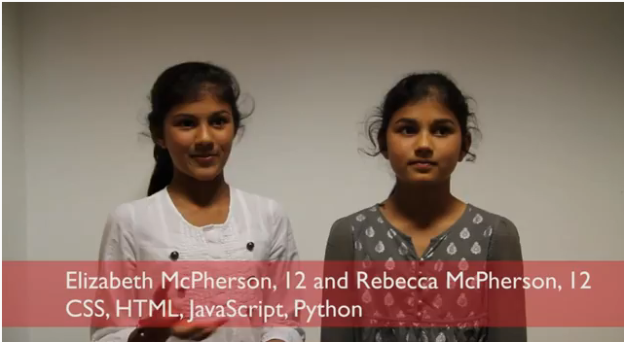
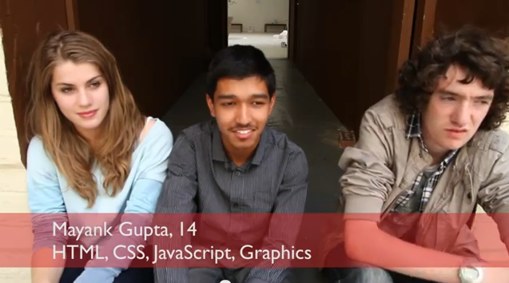
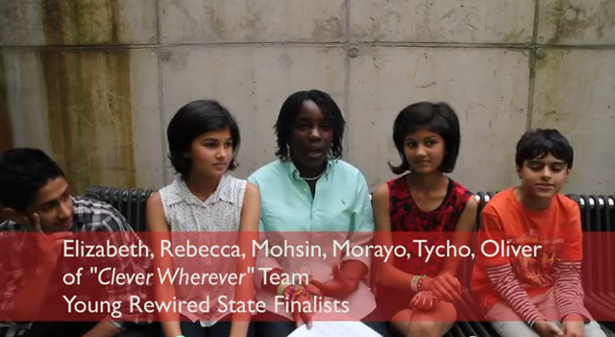

Hero break…

Slide 15
THE APP IS KING

Slide 16
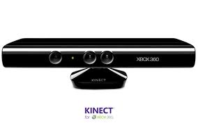
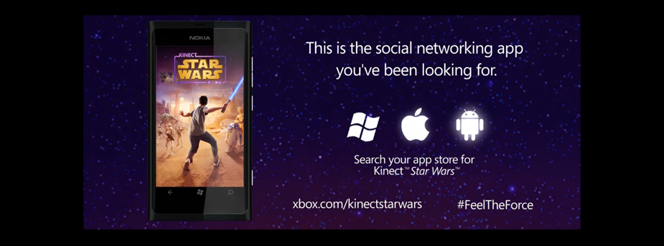

Kinect Star Wars

Slide 17

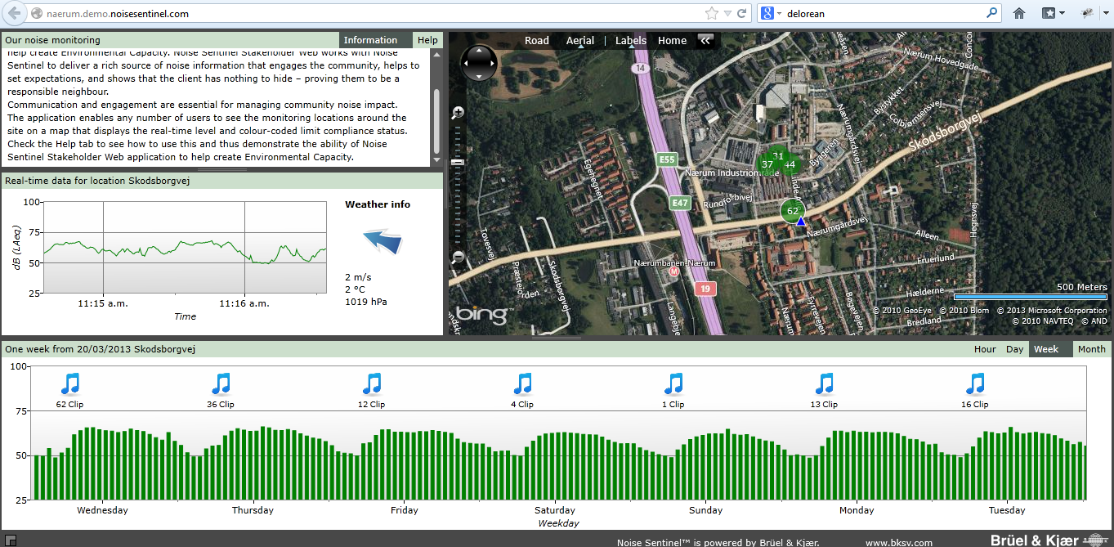
Noise Sentinel

Slide 18
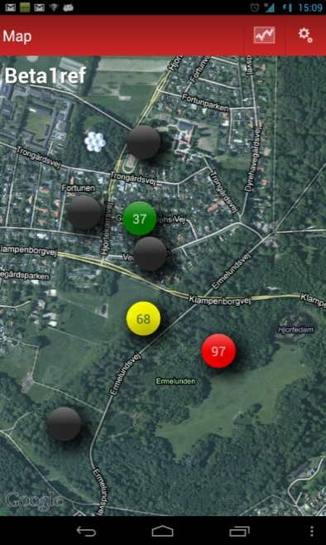
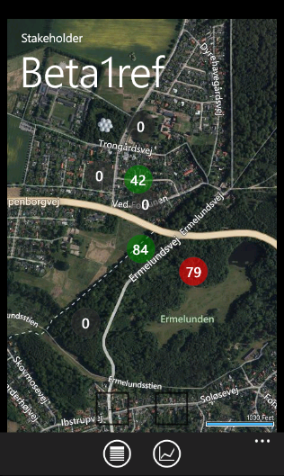
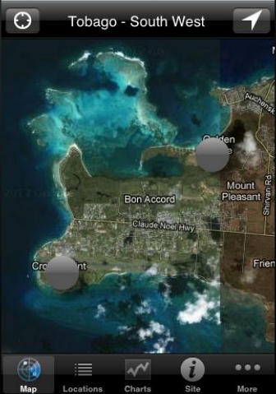
Noise Sentinel

Slide 19
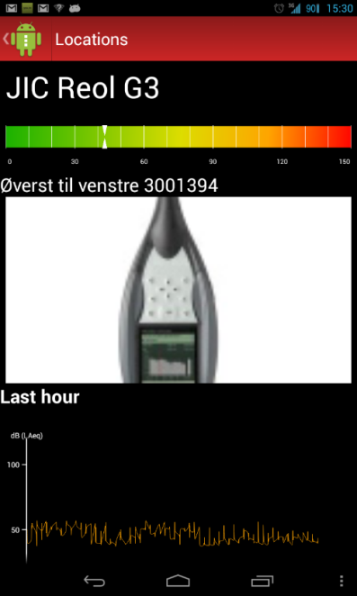
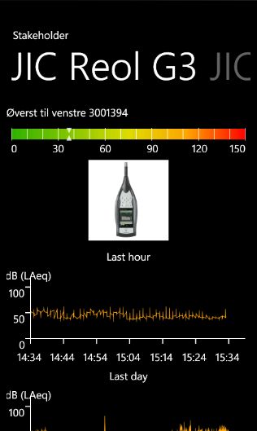
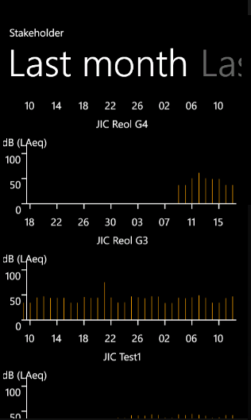
Noise Sentinel

Slide 20

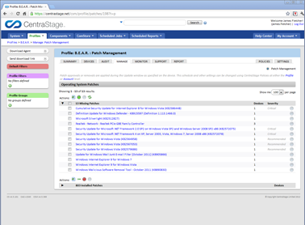
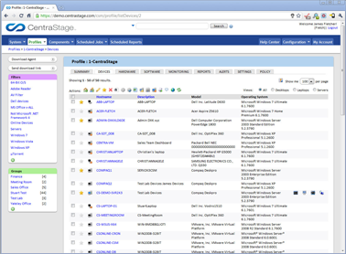
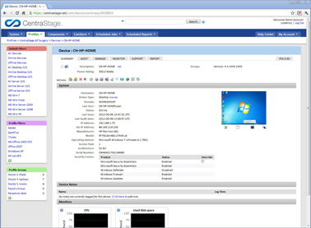
CentraStage

Slide 21
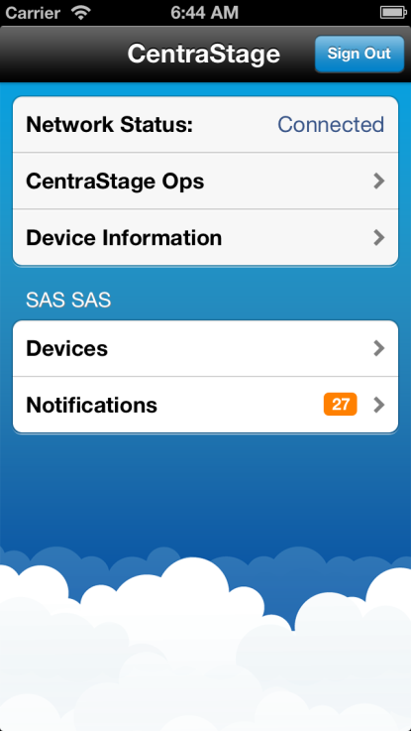
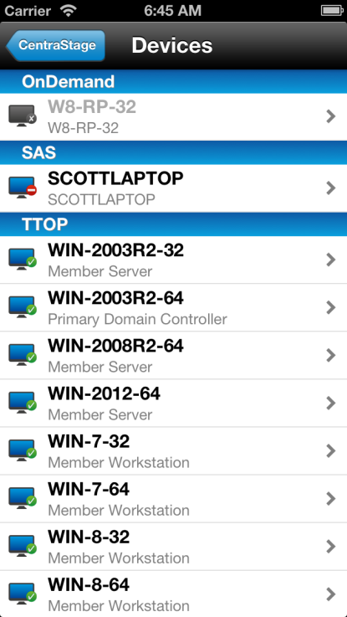
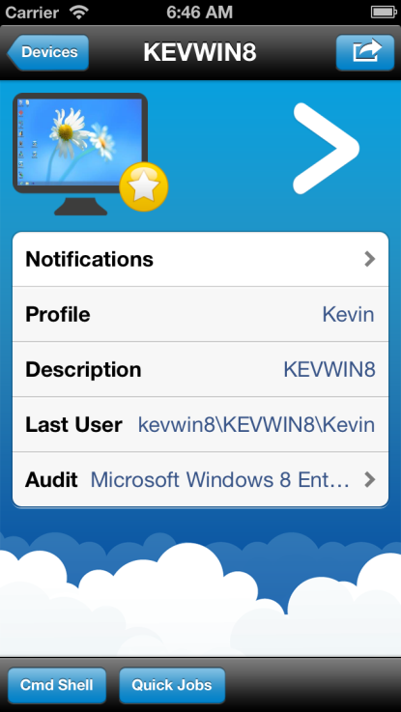
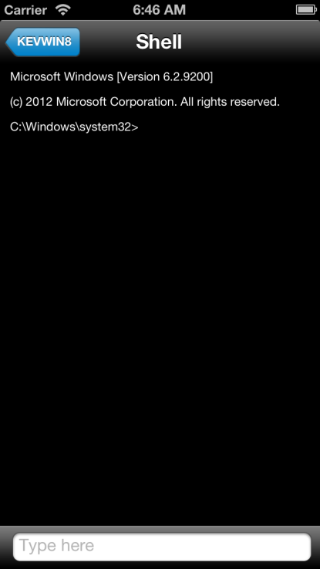
CentraStage

Slide 22
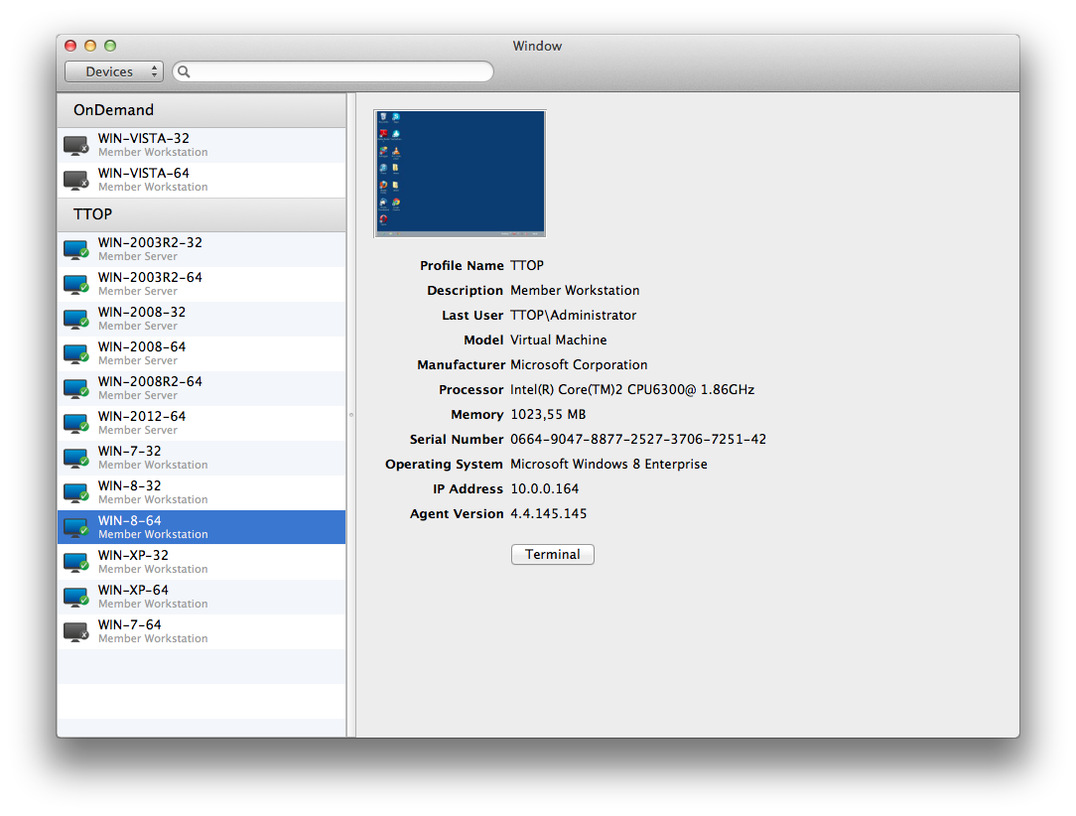
CentraStage

Slide 23

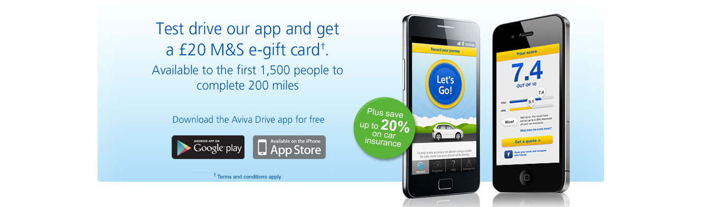

Aviva Drive

Slide 24

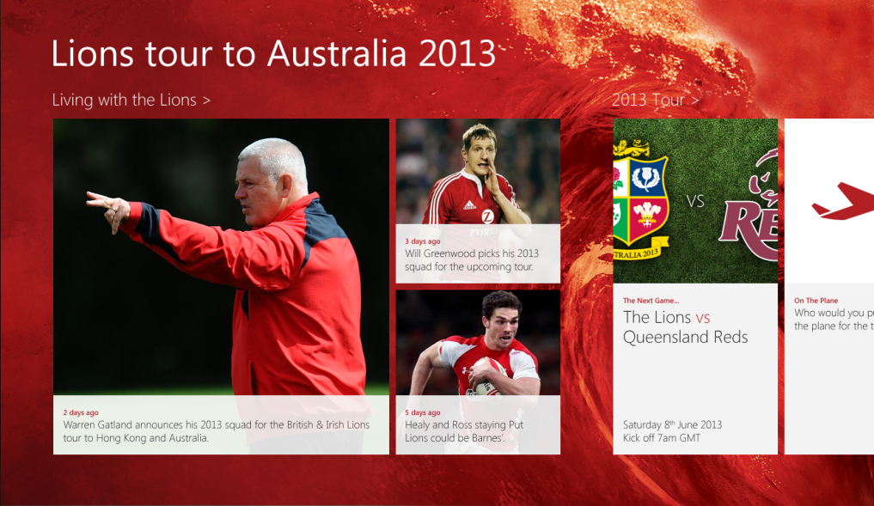
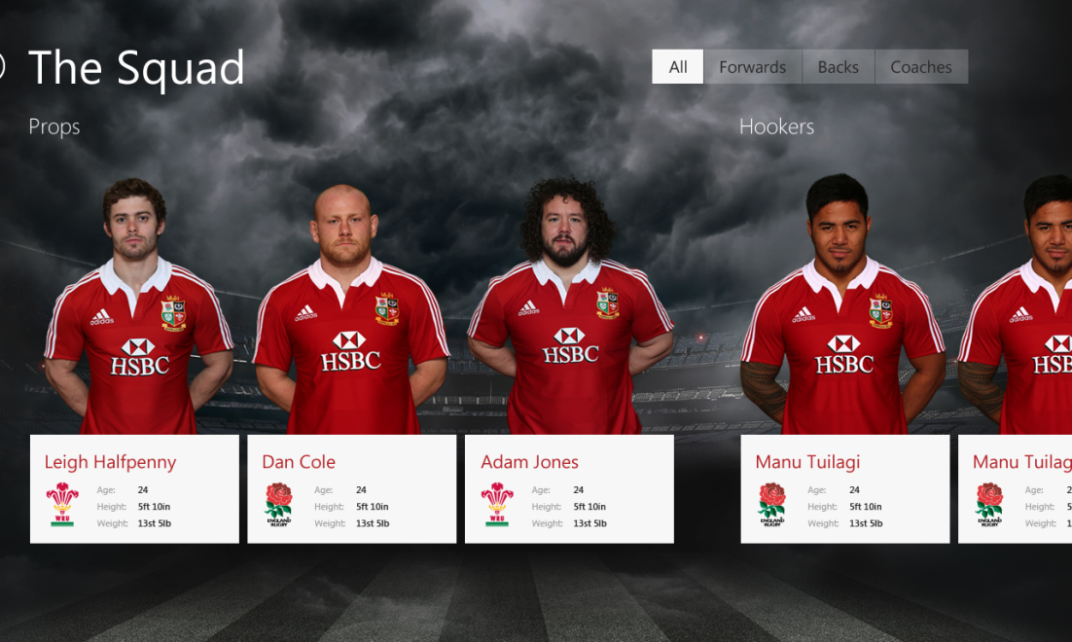
British & Irish Lions

Slide 25

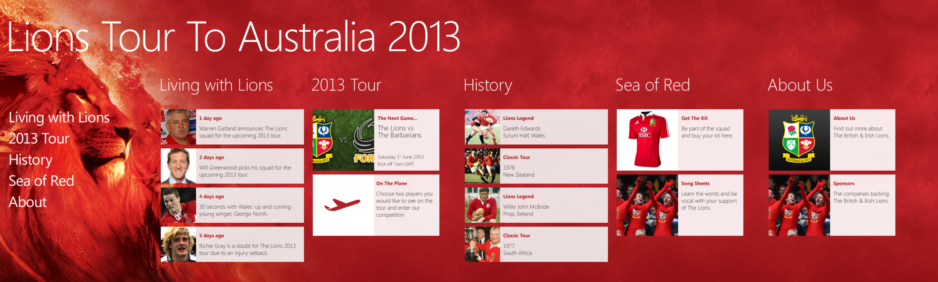
British & Irish Lions

Slide 26
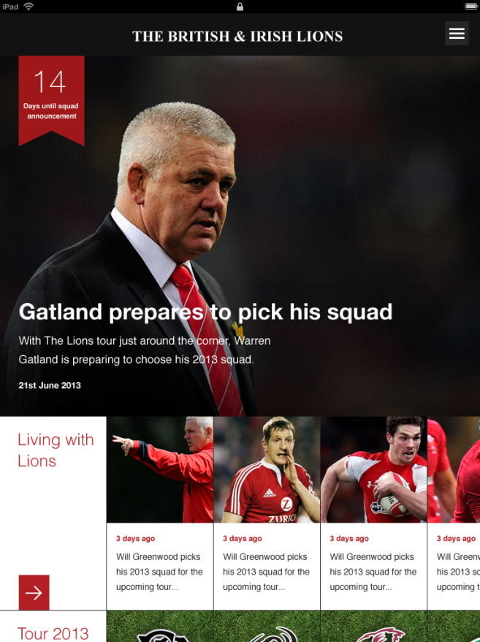
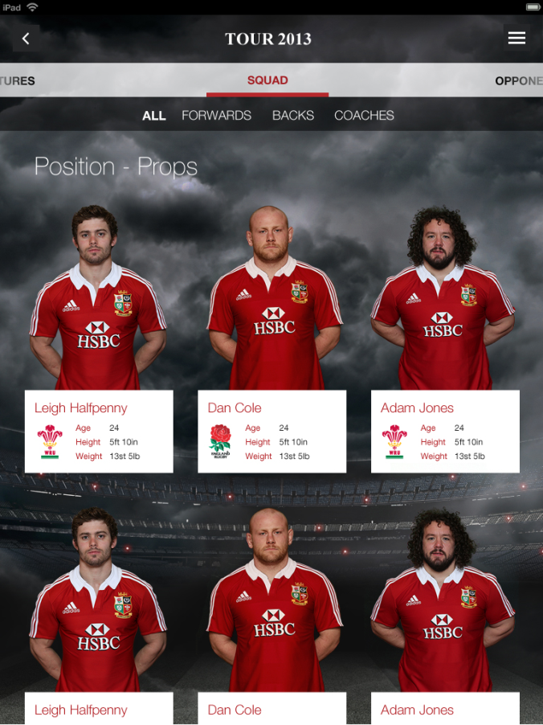
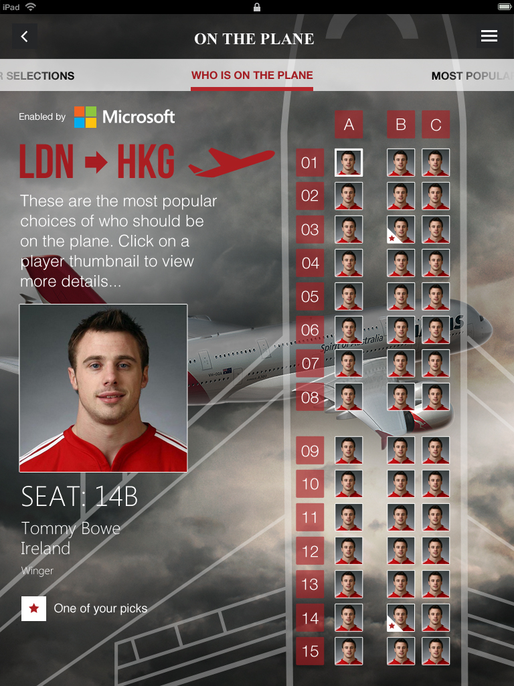
British & Irish Lions

Slide 27
British & Irish Lions
UI (Win8)
SQLite
SQL Server
WinRT
UIs (WP7 & WP8)
Silverlight
Core Logic
WebAPI
Umbraco
UI (Droid)
PCL
.Net4
.Net4
Xamarin.Android
UI (iOS)
DTO Entities
Xamarin.iOS
PCL

Slide 28
KEEP CALM AND GET CROSS

Slide 29










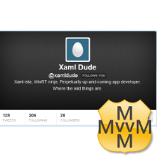














Superhero Break…

Slide 30

The Future…
v1
v2
v3
ViewModel++
Binding++
Async++
Patterns++
AutoViews…
INPC
DataBinding
.iOS
.Android
.WP
PCLs
Plugins
.WinStore
.Wpf
‘Clean’
CoreCross
.Mac
Nov ’11
to
Mar ‘12
Apr ’12
to
Oct ‘12
Nov ’12
to
Jun ‘13

Slide 31
KEEP CALM AND EAT LUNCH

Slide 32
What I hope we covered
Mvc->Mvvm->Mvx
MvvmCross Hands-On
Key Goals
Real World Apps
The Future

Slide 33


Hot Tuna Day
London, May 13th
mvvmcross.eventbrite.com
MAY 13th

Slide 34

Megahero break

Slide 35
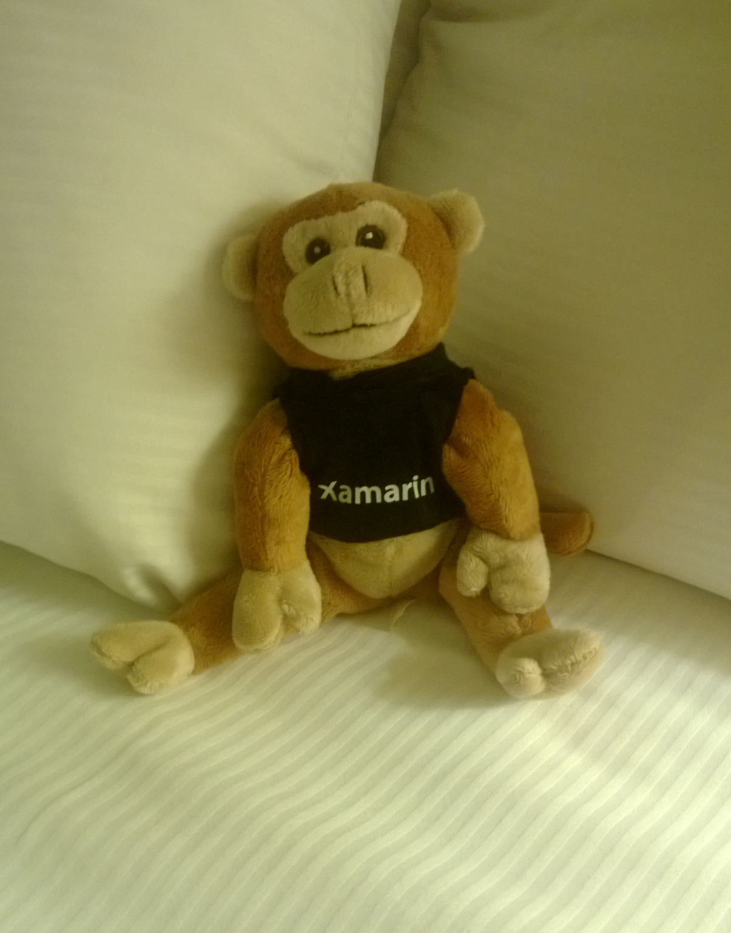
Thanks…
For listening
For Evolve
For the platforms

Slide 36

Thanks…
Stuart Lodge
me@slodge.com
@slodge
http://cirrious.com
http://slodge.blogspot.com
http://github.com/slodge/mvvmcross

Slide 37
And one last demo ?

